Slide 1
.NET Diagnostic Tooling
with AI

Slide 2

Jonathan Peppers
Principal Software Engineer
.NET MAUI

Slide 3
Agenda
01
.NET Diagnostic Tools
02
AI & Opinions
03
Demo: slow app
04
Demo: memory leak
05
Recap

Slide 4
01
.NET Diagnostic Tools

Slide 5
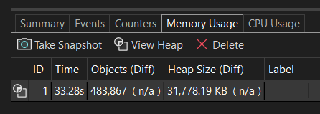
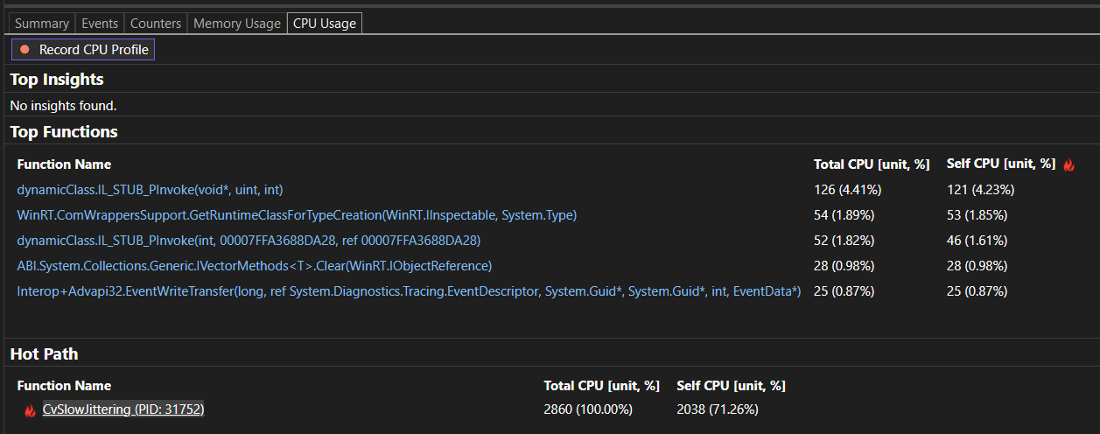
Visual Studio: Windows applications running on Windows
F5 your application in Visual Studio
Debug > Windows > Show Diagnostic Tools
CPU Usage == dotnet-trace
Memory Usage == dotnet-gcdump

Slide 6
.NET Diagnostic
(.NET Global Tools)
Tools
dotnet-trace
CPU usage or other events, .nettrace or .speedscope
dotnet-gcdump
Memory snapshot, .gcdump
dotnet-dsrouter
Connects to mobile devices, emulators, simulators

Slide 7
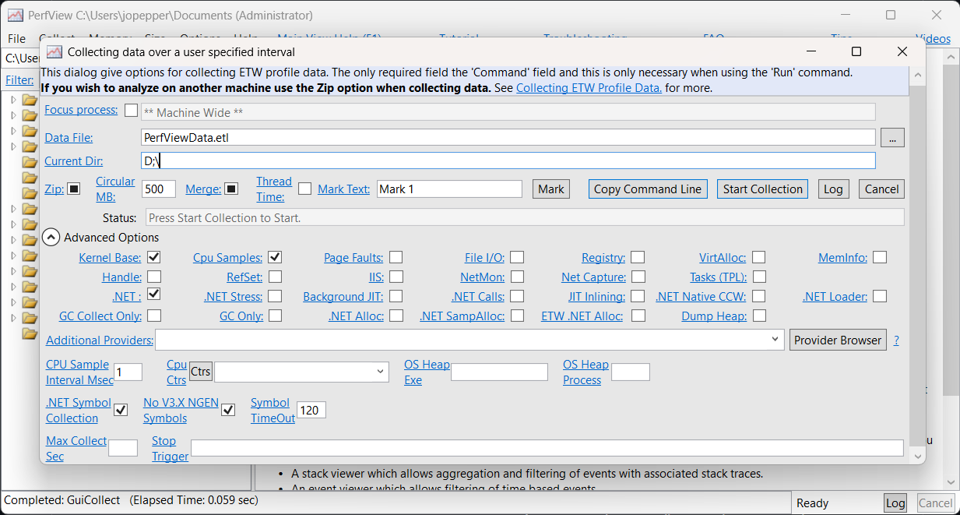
PerfView: another option on Windows
https://github.com/microsoft/perfview
More buttons than Star Trek’s command center
Great for profiling multiple processes together on Windows
Worth looking into, if you are already familiar with the other tools.

Slide 8
02
AI & Opinions

Slide 9
We want AI to be more like Ironman and less like Ultron…
I want a Copilot that is going to have a conversation with me.
Scott Hanselman

Slide 10

AI unblocks me when I’m not the expert…
Think of it like Intellisense/code completion, it is a productivity tool and not a replacement for me.

Slide 11

AI
If AI finds a performance problem, it’s likely the obvious one I should go fix!
At least today, AI can be a similar skill level as a “junior” engineer.

Slide 12
03 & 04
Demos!

Slide 13
AI is not deterministic, hope these demos work!

Slide 14

Demo: slow app
We’ll look at a .NET MAUI application on Android and how we can improve it.

Slide 15

Demo: memory leak
We’ll look at a .NET MAUI application on Android and how we can improve it.

Slide 16
05
Recap

Slide 17
Recap
Demos
dotnet-trace .nettrace
dotnet-gcdump .gcdump
Diagnose “slow” code
Try the copilot button in Visual Studio
Diagnose memory leaks
Used an MCP server to enable copilot to investigate

Slide 18



Recap
AI
When I’m not an expert…
AI’s Investigations
Profile your app today!
AI is a tool to unblock me. Think of it as a productivity tool, not a replacement.
If AI finds a problem; it’s probably the obvious one I should fix!
We just made the tooling around dotnet-dsrouter much easier to use! If you haven’t tried lately, maybe there are some “easy wins” in your applications.

Slide 19
Try out .NET 10 we hope you like it!

Slide 20
Thank you

